Slide 1

Data Science in Context: Ebola deaths by country using Tidyverse
Presentation
By
Raghed Mirza

Slide 2
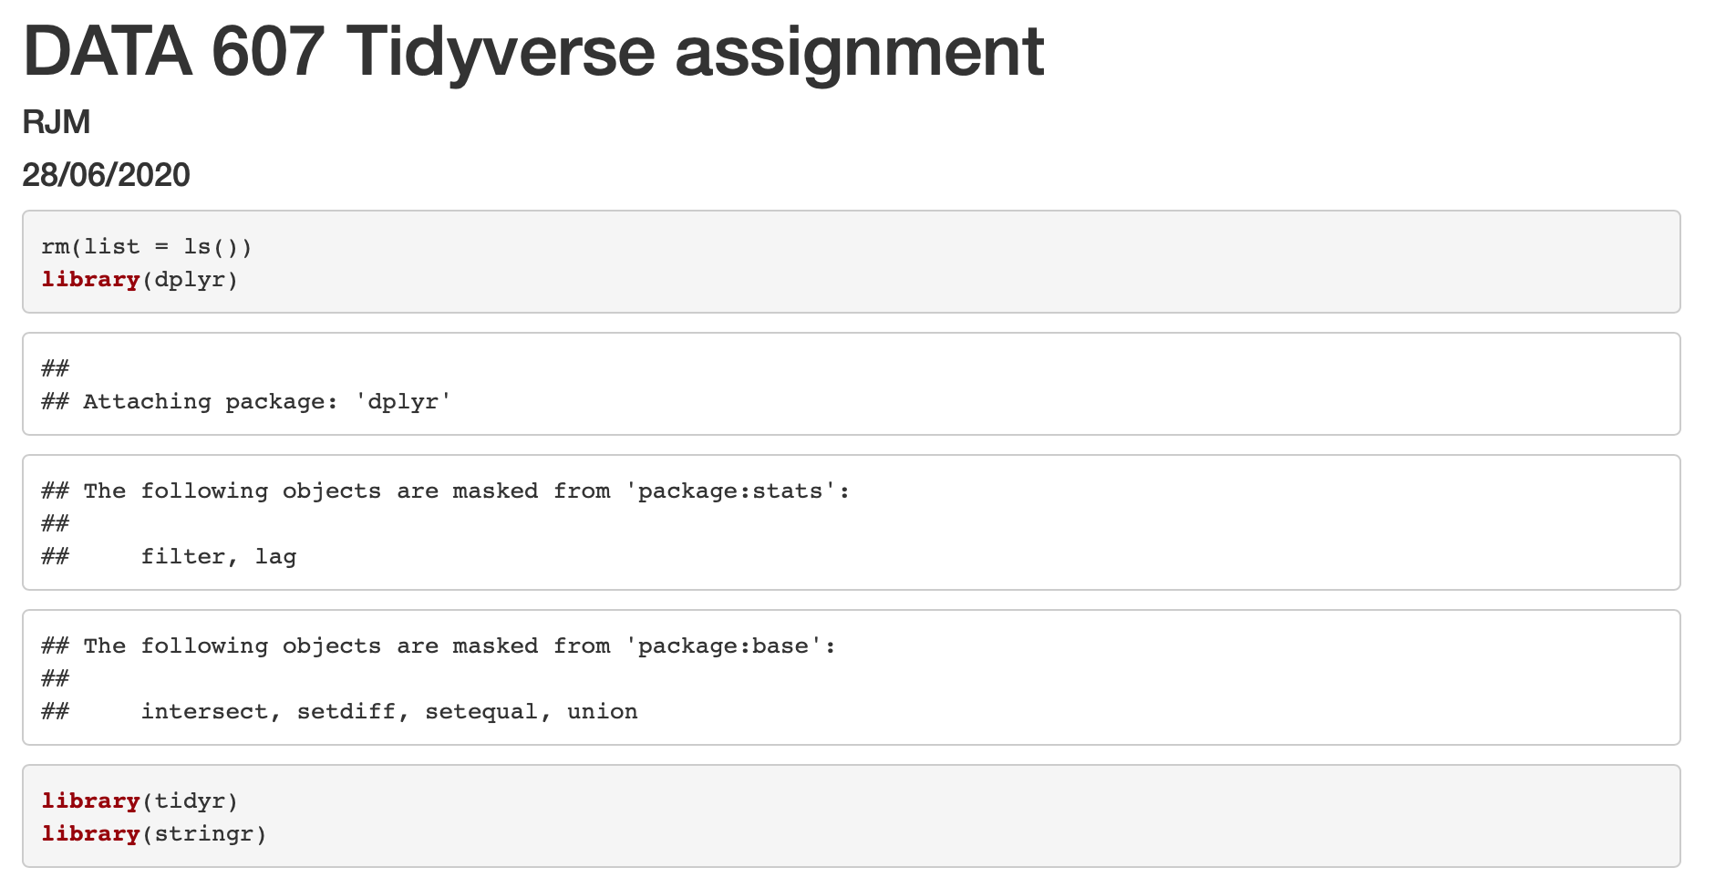
Calling the related libraries in R

Slide 3
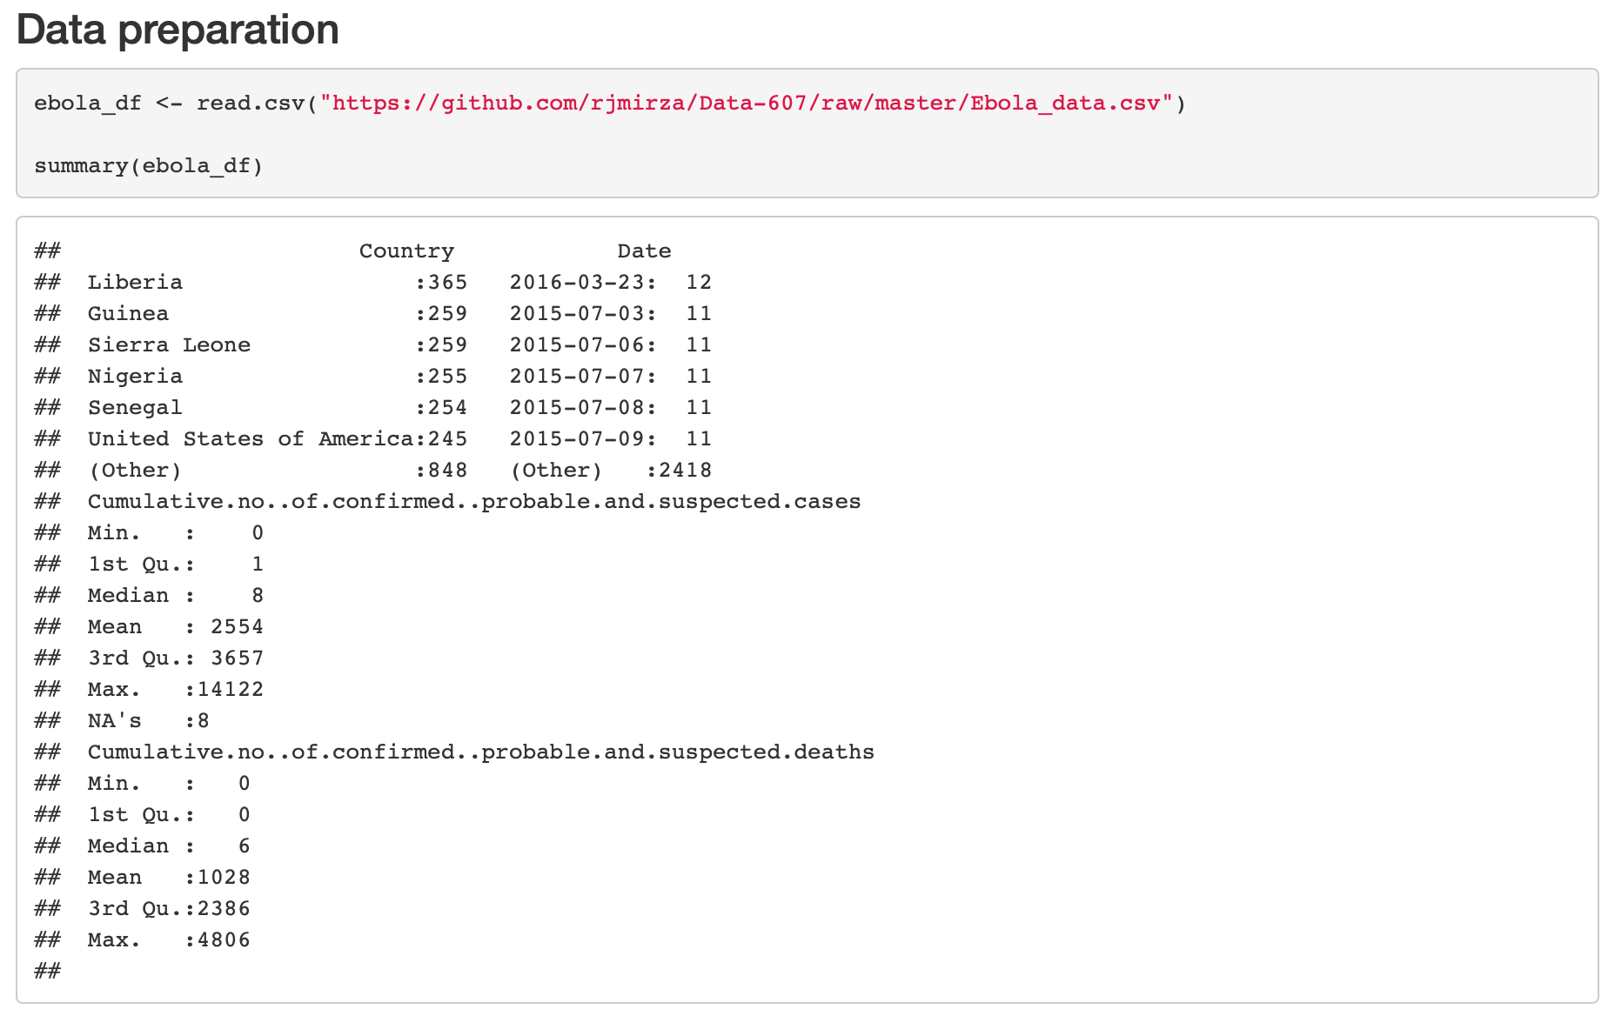
Preparing the data
Data was downloaded from:
https://www.kaggle.com/imdevskp/ebola-outbreak-20142016-complete-dataset/data

Slide 4
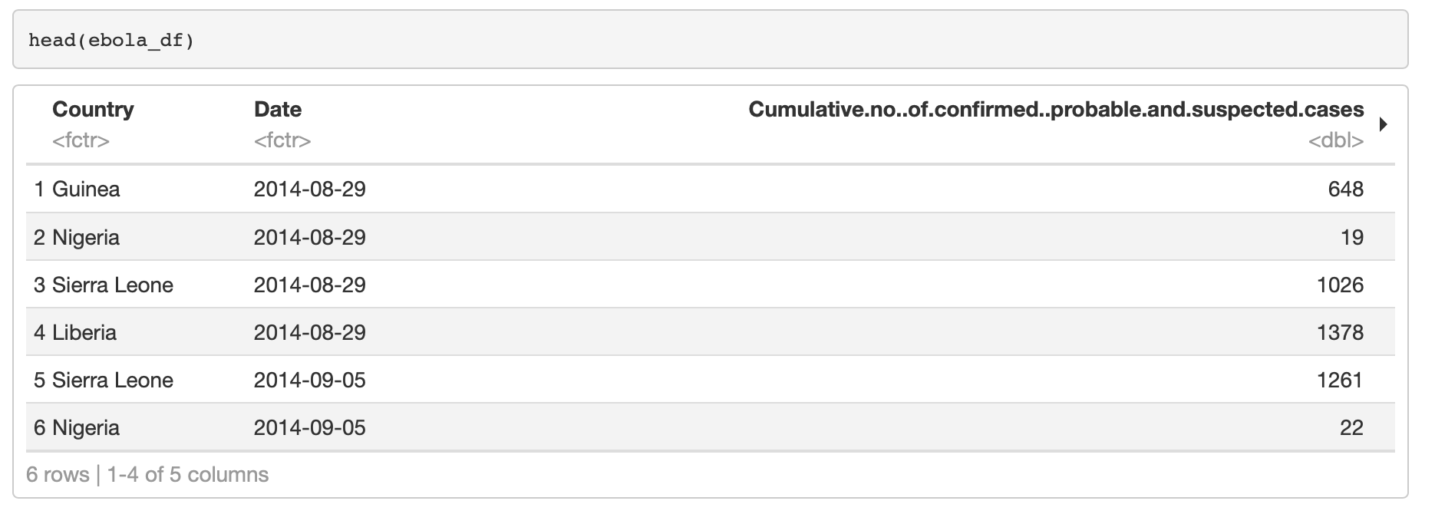

Slide 5
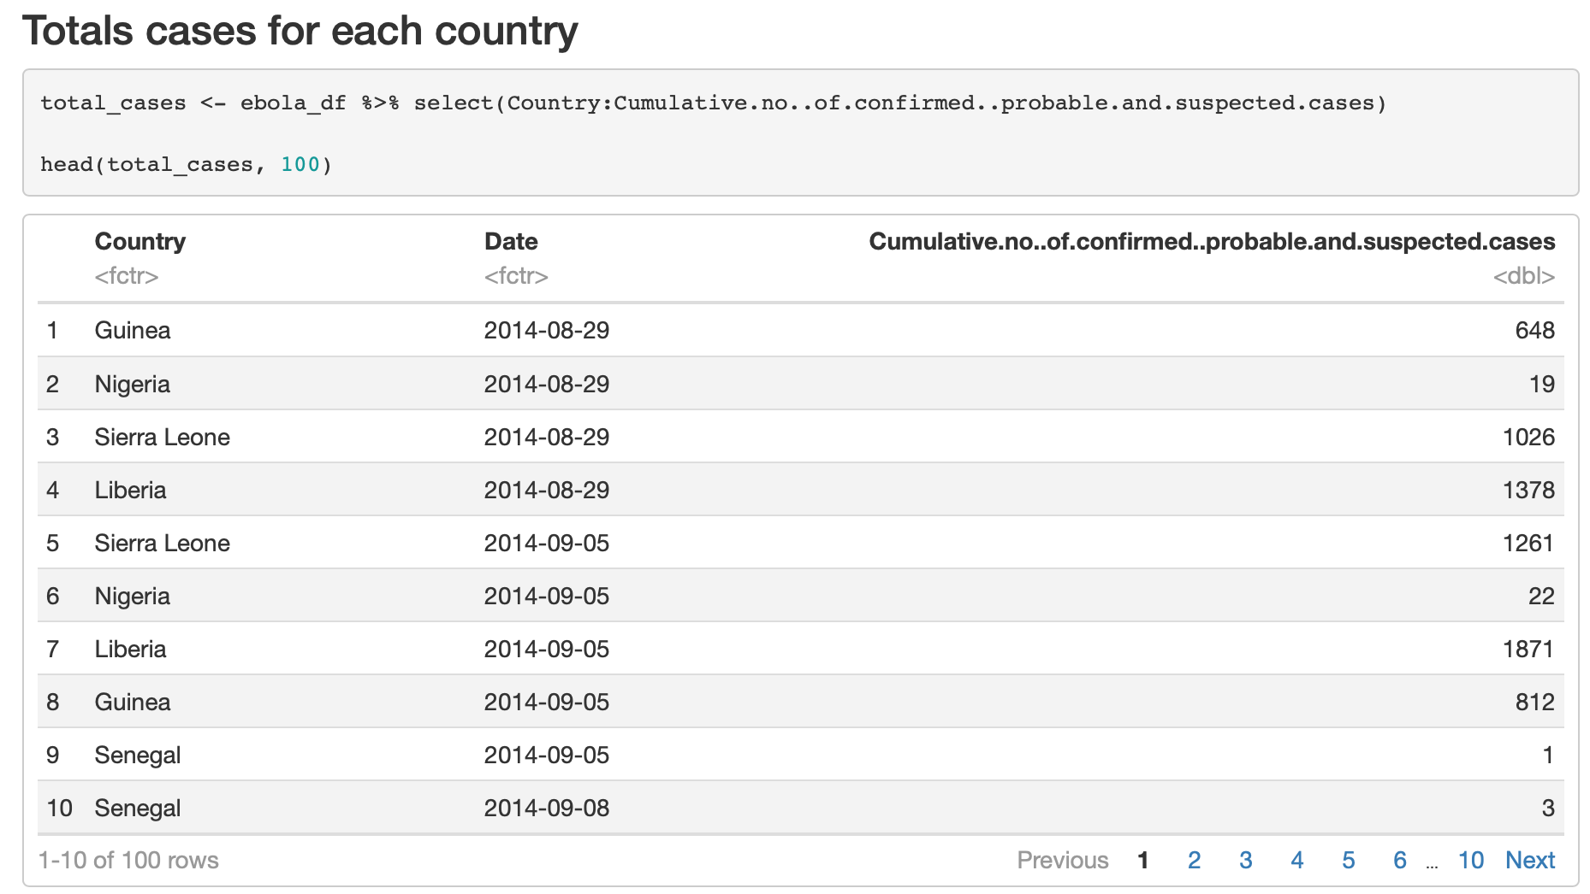

Slide 6
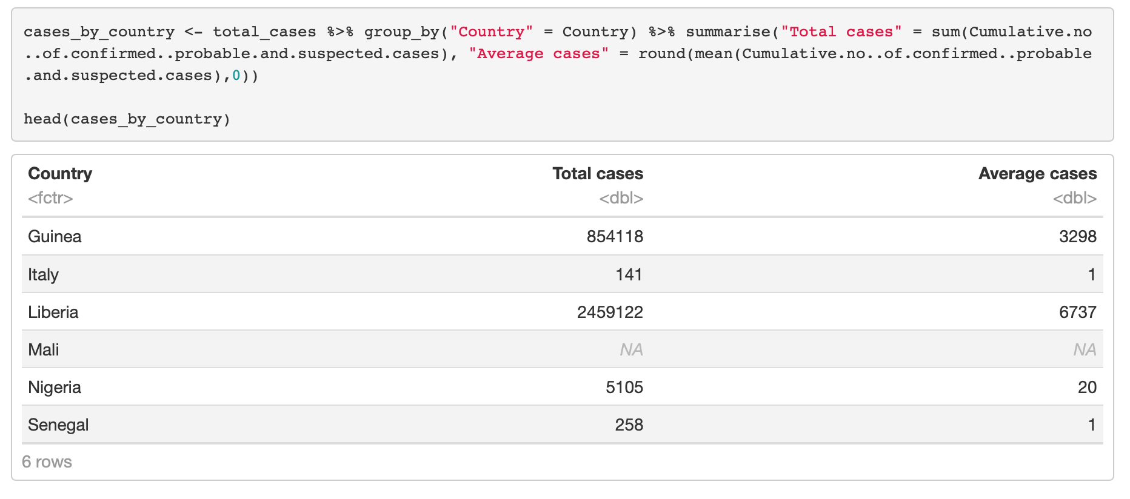

Slide 7
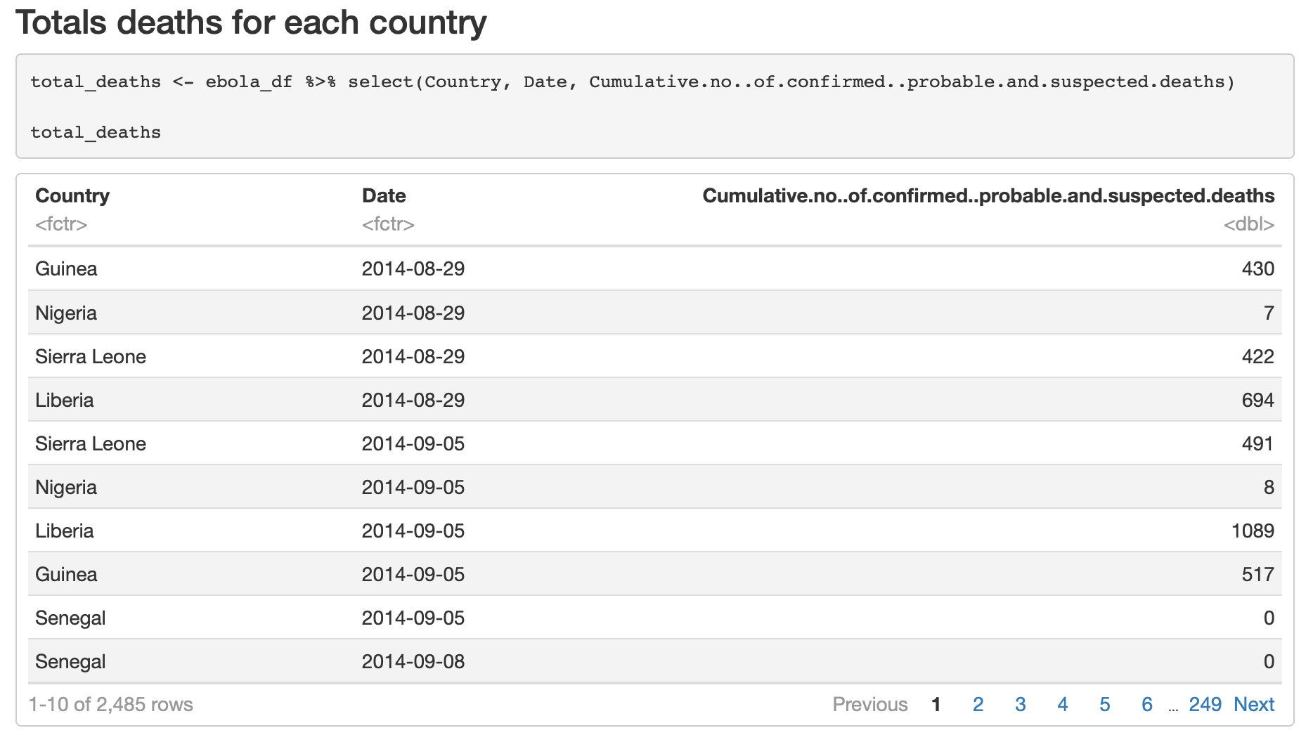

Slide 8
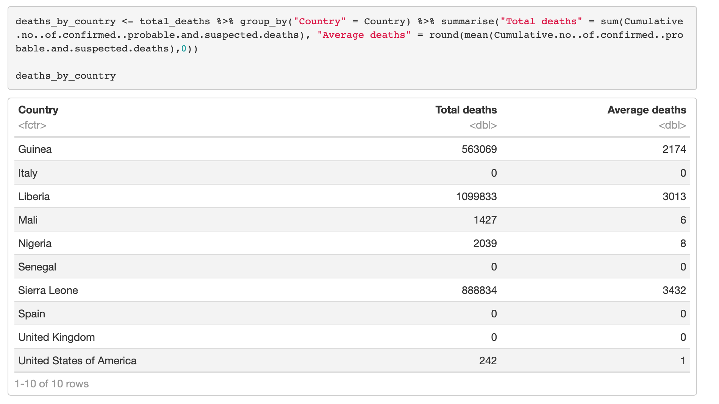

Slide 9
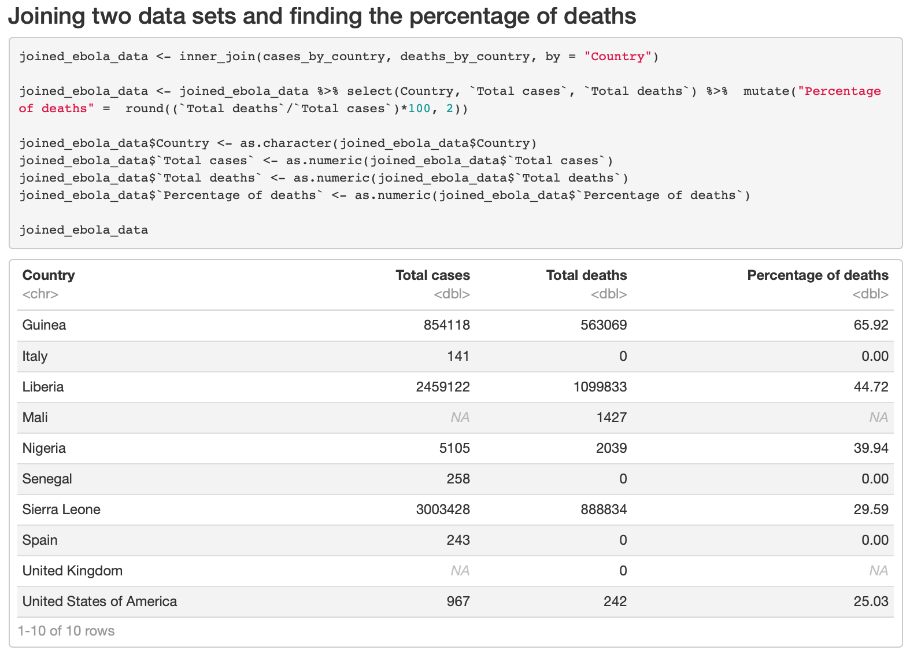

Slide 10
Link to the presentation code and output on RPubs
https://rpubs.com/Raghed/633514

